Slide 1
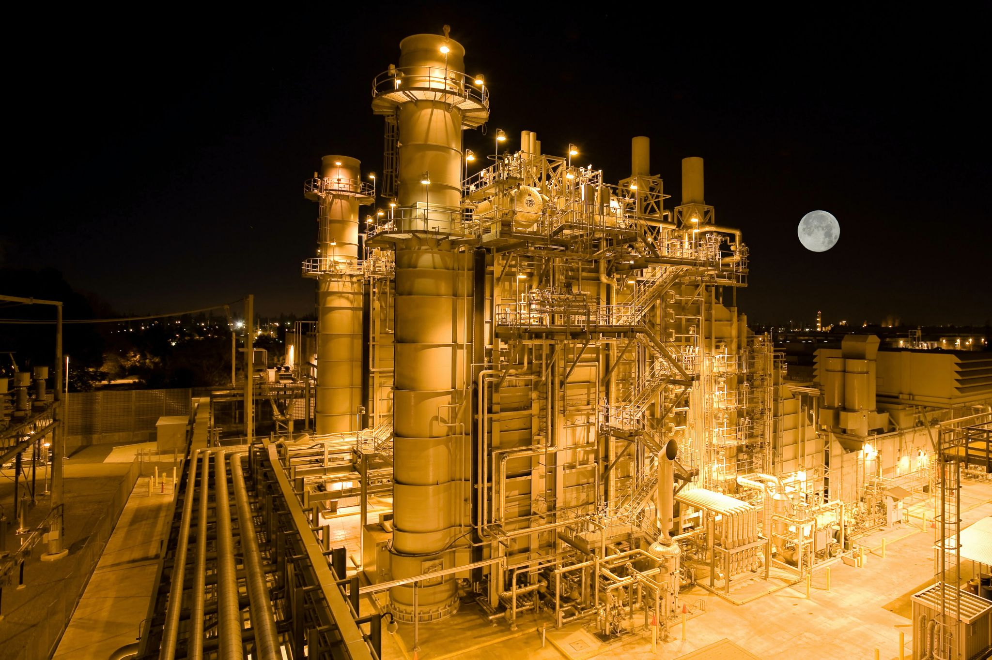
MATA ANUSAYA
ENERGY PRIVATE LIMITED
A solution fo every engineering problem
SERVE YOU BETTER
OPERATION
MA Offers total utility system of all sectors. Our unique approach allows you to chose the degree of outsourcing service for your plant
VISIT :www.mataanusaya.com
CALL : 7987574207
EMAIL TO: teamengineering@mataanusaya.com
MAINTENANCE
We make regular rounds to check whether the operational conditions and performance of facilities are within the design parameters and fix any defects found manner in a prompt. In accordance with an annual in- operation maintenance plan, we sustain optimal operation conditions, thus preventing failures or sudden shutdowns of the facilities.
COMISSIONING
Start up and commissioning services-supporting client at final stage of erection, trial run and commissioning of the plant.
A B O U T U S
MATA ANUSAYA visibly,its "Main Strength" lies in our team, as we honour and value our employees at all levels, Our Employee have been carefully selected for their knowledge and expertise in areas of integrated facility management, services & projects. Our company value system and spirit thrives on our team building, knowledge sharing and focused approach attitude.
OVERHAULING
The specialised activity of boiler overhauling is undertake and carried out by us giving due attenuation every minute details for both turbine and boilers

Slide 2
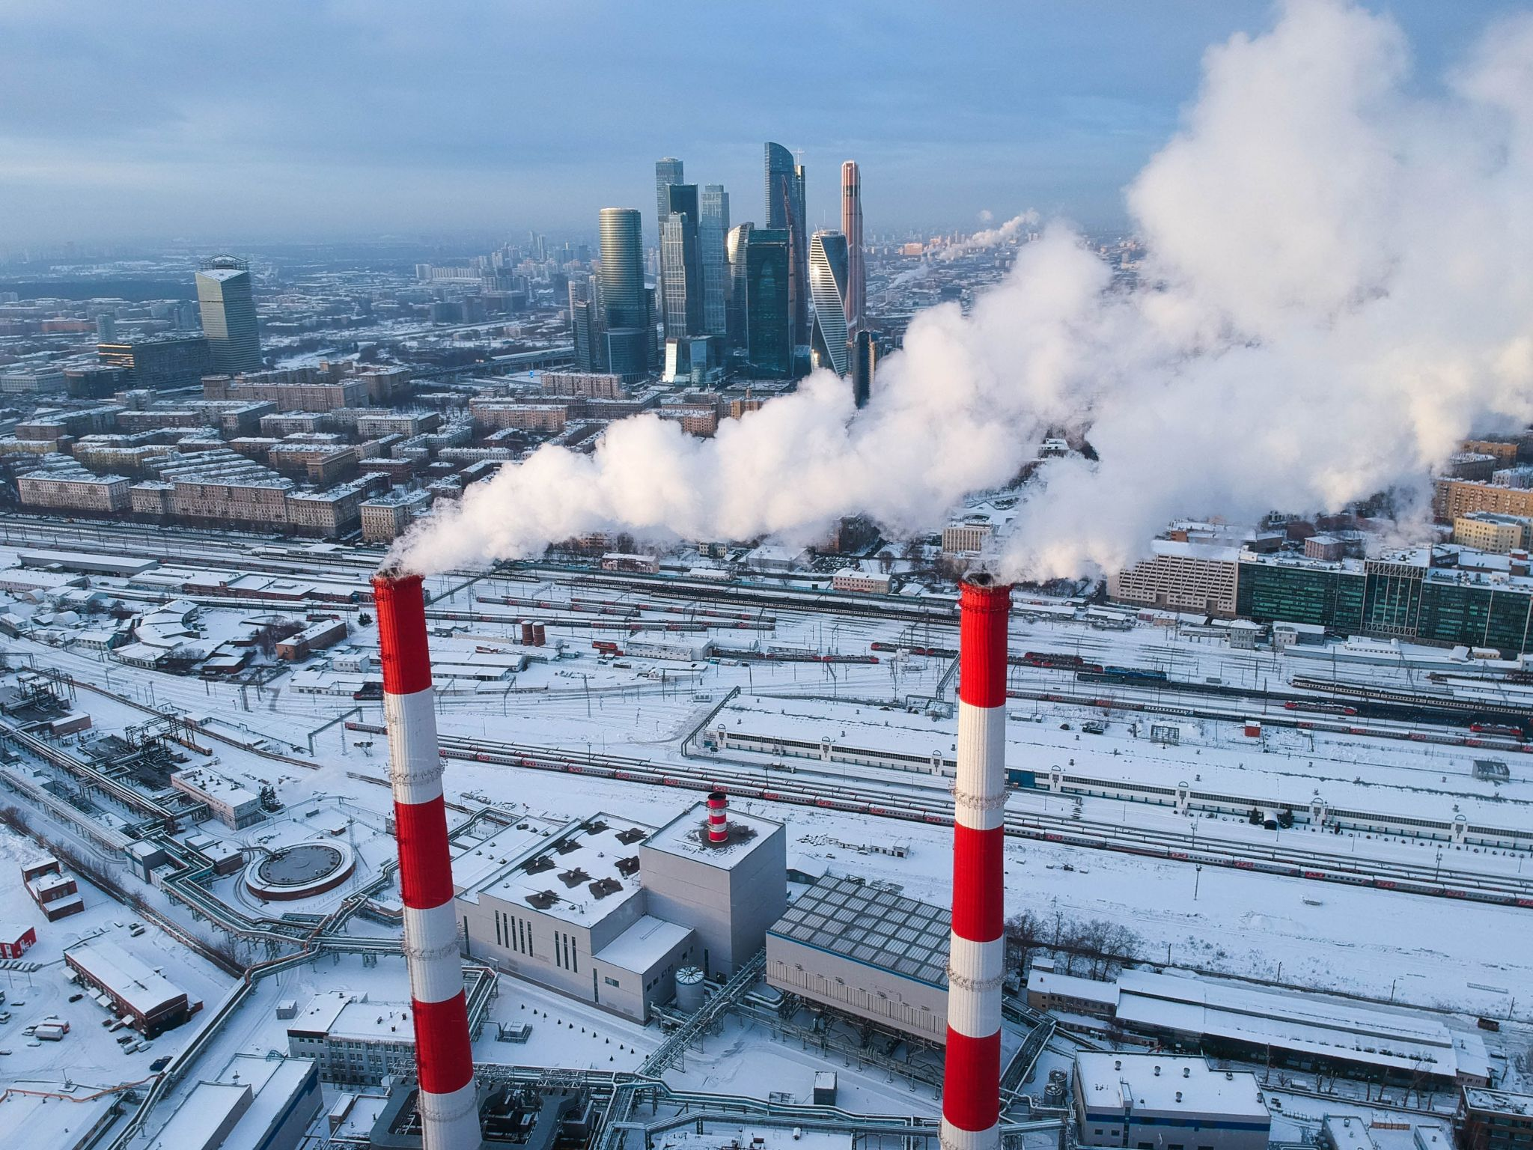
COMPANY
MATA ANUSAYA
In consonance with our mission to provide reliable power at
the most competitive lifetime cost per Megawatt, we offer
comprehensive operation and maintenance services for power plants,through our own experienced manpower and proprietary
processes.
The key objective is to keep our customer’s investments productive, by continuously optimising their operations with an aim to enhance availability, output, efficiency of power plant along with power plant life. A scientific program of preventive maintenance and periodic repair ensures that the plant remains in peak condition.

Slide 3
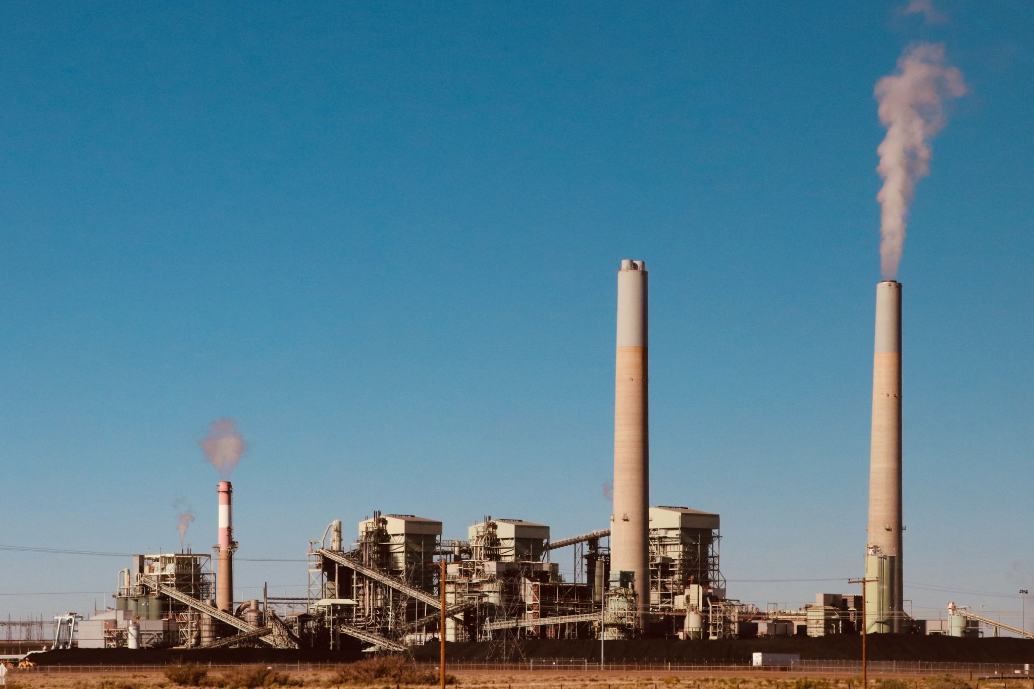
Our Aim:
To run the plant in Energy efficient with zero breakdown To find the right job for the right people at the right time and to attain a leading position in the ENGINEERING, HR Outsourcing space.
Our Mission:
To become a Best Service Provider by adding values to our Clients through reduced cost with Quality, Satisfaction and superior delivery.

Slide 4
Our Services:
With a blend of rich experience we offer services in the following areas
Engineering consultant
E & I – Projects and FMS
Commissioning
Shut down and annual maintenance of power and industrial boilers
Boiler repairing work through channel partner under IBR
O & M of Boilers / Heating Systems
O & M of Water treatment plant
Energy audit
E&I Project cum AMC Services
Chemical treatment of boiler and cooling tower
Manpower consultancy
Industrial/building Acoustic systems
Staffing & Support services

Slide 5
ENERGY AUDIT
1.Conducting Energy audit at site & Identification of opportunities / gaps.
2.Soft solutions to reduce energy consumption & energy wastage.
3.Execution of actions through base projects to reduce energy consumption & energy wastage.
4.Preparing energy report plant power consumption and tracking the improvement.
5.Creating awareness and energy improvement drive among plant team.
6. Preparing yearly energy report showing plan Vs actual on site energy improvement.
7.Identification of solution /improvement the energy conservation and implementations of the same.

Slide 6
OUR APPROACH
MIS
PEOPLE
CLIENT
PROCESS
SYSTEM

Slide 7
Specializations
With our rich Experience persons in All Engineering cum boiler field Instant solutions for your instant needs
Our Working Strategy
Based on our client as well as our Engineers visit report decision will take for necessary modification and repair for running the plant in Energy efficient. Based on Our client needs, resumes are short listed from our database according to company requirements. Candidates are tested on the basis of experience and attitude. After screening the right candidates are selected.

